Slide 1
How to apply statistics
Vinay Mahajan
Varsha Mahajan
Sampling Theory
Design of Experiments

Slide 2
Sampling Theory
Study of understanding relationship between Samples drawn and the population
Sampling theory is designed for the following:
Statistical estimation
Supports in estimating unknown population parameters
Estimate can be a single value – point estimate
Estimate can be expressed as a value in an interval – interval estimate
Interval estimate has two limits; upper limit and lower limit within which the parameter value may lie in
Testing of hypothesis
Based on the statistical estimation; sampling theory helps us deduce whether we reject or accept the defined hypothesis
Whether the observed difference is by chance or is significant
Statistical inference
Helps in making a generalized conclusions about the population from the studies based on the samples drawn from them

Slide 3
Sampling Theory
The parameter value may be given and it is only to be tested if an observed ‘statistic’ is its estimate.
The parameter value is not known and we have to estimate it from the sample.
To compare the observed and expected values and ascribe the difference to the fluctuations of sampling
Estimate the population parameter from the sample
To find the degree of reliability of the estimate; Examination of the reliability of the estimate i.e., the problem of finding out how far the estimate is expected to deviate from the true value for the population.

Slide 4
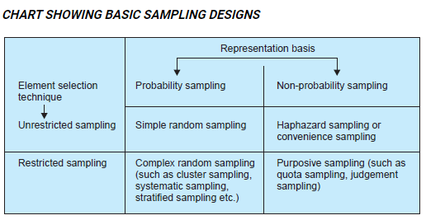
Sampling Design
Random and chance probability
Ensures blind
Equal chance for all the factors to be included
Can measure the errors of estimation and significance
Ensures Statistical Regularity
No personal bias
Personal element entering leading to bias
No possibility of equal chance for all the factors to be included
Cannot measure sampling error due to high bias
Small inquiries and measures can be used due to advantage of time and money
Convenient and relatively inexpensive
https://www.wisdomjobs.com/e-university/research-methodology-tutorial-355/different-types-of-sample-designs-11471.html

Slide 5
Simple Random Sampling
A sampling technique where every item in the population has an even chance and likelihood of being selected in the sample. Here the selection of items completely depends on chance or by probability and therefore this sampling technique is also sometimes known as a method of chances.
It gives each element in the population an equal probability of getting into the sample; and all choices are independent of one another.
It gives each possible sample combination an equal probability of being chosen.
The above principles apply to sampling without replacement.
In case of sampling with replacement, each element has equal probability of getting picked up in every turn even before the next new item is picked.

Slide 6
Systematic Random Sampling
Systematic sampling is a statistical method involving the selection of elements from an ordered sampling frame.
The sampling starts by selecting an element from the list at random and then every k^{th} element in the frame is selected, where k, is the sampling interval
k=N/n
where n is the sample size, and N is the population size.
It is not the same as SRS because not every possible sample of a certain size has an equal chance of being chosen
Systematic sampling is to be applied only if the given population is logically homogeneous, because systematic sample units are uniformly distributed over the population.
The researcher must ensure that the chosen sampling interval does not hide a pattern.
Systematic sampling may also be used with non-equal selection probabilities.

Slide 7
Stratified Sampling
Stratification is a method of element selection from the population by dividing it in to partitions or subgroups
Stratification is the process of dividing members of the population into homogeneous subgroups before sampling.
The strata should define a partition of the population.
Within the strata Simple random sampling or stratified sampling can be applied for element selection
The objective is to improve the precision of the sample by reducing sampling error

Slide 8
Stratified Sampling
The objective of stratification is
Collective exhaustive: every element in the population is a part of the selection process
Mutually exclusive: each and every element is a part of only one stratum
Stratified sampling strategies:
Proportionate allocation: each strata is proportional to the total population
E.g. “m” smokers, “n” non-smokers (m+n=N ; total population); the samples in the two strata would be proportional to m/M and n/M respectively
Optimum allocation (disproportionate allocation): The sampling fraction of each stratum is proportionate to both the proportion (as above) and the standard deviation of the distribution of the variable. Larger samples are taken in the strata with the greatest variability to generate the least possible overall sampling variance.

Slide 9
Cluster Sampling
Cluster sampling involves dividing the population into subgroups,
Each subgroup should have similar characteristics to the whole sample.
Instead of sampling individuals from each subgroup, you randomly select entire subgroups.
Cluster sampling is a sampling plan used when mutually homogeneous yet internally heterogeneous groupings are evident in a statistical population.
In this sampling plan, the total population is divided into these groups (known as clusters)
A simple random sample of the groups is selected. The elements in each cluster are then sampled.
https://en.wikipedia.org/wiki/Cluster_sampling#Applications_of_cluster_sampling

Slide 10
Cluster Sampling
All elements in each sampled cluster are sampled, then this is referred to as a “one-stage” cluster sampling plan
A simple random subsample of elements is selected within each of these groups, this is referred to as a “two-stage” cluster sampling plan.
An example of cluster sampling is area sampling or geographical cluster sampling. Each cluster is a geographical area. Because a geographically dispersed population can be expensive to survey, greater economy than simple random sampling can be achieved by grouping several respondents within a local area into a cluster. It is usually necessary to increase the total sample size to achieve equivalent precision in the estimators, but cost savings may make such an increase in sample size feasible.
https://en.wikipedia.org/wiki/Cluster_sampling#Applications_of_cluster_sampling

Slide 11


Slide 12
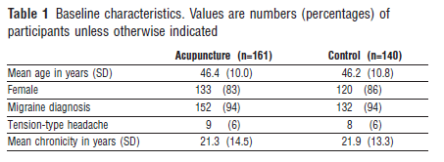
Assignment
Use the Acupuncture data of 401 patients.
Consider this as your population
Randomly choose 25 patients from the population for each of the treatment groups and check if the summary is close to the population statistics as shown below
Save the calculation with the following name “Day_5&6_assignment1_yourname.doc”

Slide 13
Assignment
Use the Acupuncture data calculate the summary statistics (mean, sd, n and change from baseline at one year) for the headache score for both the treatment group and the control group.
Save these with the following name “Day_5&6_assignment2_yourname.doc”

Slide 14
Design of Experiment
DOE is an applied branch of statistics
Deals with planning, conducting, analyzing and interpreting tests
Is a systematic method to determine the relationship between factors affecting a process and the output of that process
It is a process to optimize the output
Used in various fields like agriculture, medicine, biology, marketing, sales, research, industry, governmental organization and many more…

Slide 15
Principles of experimental designs
Replication / Repetition – to provide an estimate of experimental error
Randomization – to ensure that this estimate is statistically valid
Local control – to reduce experimental error by making the experiment more efficient

Slide 16
Needs of experimental design
Variable/s of interest – a changing quantity which can be measured
Factors –
These are the influencers
These are controlled to obtain a response
These are independent of each other
Response variable/s
These are the effects or responses
These are dependent on the factors

Slide 17
Expectations from a good experimental design
Causation
Allows the experimenter to make causal relationship between independent variables and dependent variable
Control
Allows the experimenter to rule out any confounding effects from extraneous variables
Variability
It reduces variability within treatment conditions, which makes it easier to detect differences in treatment outcomes

Slide 18
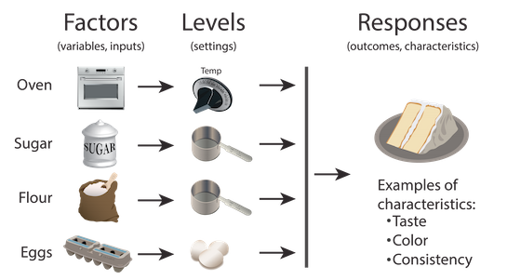
Cake baking experiment
Factors | Levels | Responses
Controllable / Uncontrollable |  | Outcome variable
Mixing method Tools The sequence of mixing People involved (Noise) | Temperature setting Sugar content Flour Eggs
https://www.moresteam.com/toolbox/design-of-experiments.cfm

Slide 19
Completely Randomized Design
Completely Randomized Design
Randomly assigning participants to one of the treatments being compared
Relies on randomization to control the effects of potential causal variables that were not included explicitly in the study (lurking variables)
Based on the assumption that randomly assigning subjects will make the operating condition similar between the testing arms; make the arms homogeneous
E.g. parallel design
Cons:
Will yield less precise results when factors not accounted for by the experimenter affect the response variable
There is a lot left to the chance if not planned well and the results may be confounded

Slide 20
Randomized Block Design
Randomized Block Design
Is equivalent to stratified random sampling
The researcher divides the sample in to relatively homogeneous subgroups or blocks (analogous with “strata” in stratified sampling)
Participants within each block are randomly assigned to treatment conditions
Reduces variability and potential confounding
The treatment effect estimates are stronger within each block
In some blocking designs, individual participants may receive multiple treatments. This is called using the participant as his own control.
E.g. cross-over design in clinical trials
Blocks perform a similar function in experimental design as strata perform in sampling.
Notes:
Both divide observations into subgroups. However, they are not the same. Blocking is associated with experimental design, and stratification is associated with survey sampling.

Slide 21
Matched Pair Design
Matched Pairs Design
Special case of a Randomized Block Design
Can be used only when there are two experimental arms
Subjects are grouped in pairs based on some blocking variable e.g. age and gender etc.
Within each pair the subjects are randomly assigned to different treatments
The goal of matched pair design is to reduce the chance of an accidental bias that might occur with a completely random selection from a population.
Explicitly controls the confounding effects of the no. of lurking variables used in the block.
Advantages
Reduces participant variability
Avoids order effects
Disadvantages
Very time consuming to find exact matches

Slide 22
Latin Square Design
Latin Square Design
It is a block design
It is the case where there are same no. of experimental runs as the number of treatment conditions
Latin Square Designs are used when time is thought to have a major impact on the experiment result
Suppose we have 3 treatments A, B and C
The design would be
Days Subject 1 Subject 2 Subject 3
Day 1 treat A treat B treat C
Day 2 treat B treat C treat A
Day 3 treat C treat A treat B
Controls variation from different treatments and different sequence
Allows spread and control of additional factors from an equal number of blocks and treatments
With more than 3 blocks and treatments; a number of Latin Square Designs are possible
Latin Square Designs are equivalent to specific fractional Factorial designs
They allow experiments with relatively small number of runs
Notes:
The advantages of Latin square designs are:They handle the case when we have several nuisance factors and we either cannot combine them into a single factor or we wish to keep them separate.
They allow experiments with a relatively small number of runs.
The disadvantages are:The number of levels of each blocking variable must equal the number of levels of the treatment factor.
The Latin square model assumes that there are no interactions between the blocking variables or between the treatment variable and the blocking variable.

Slide 23
Factorial Experiments
Factorial experiments are designed to draw conclusions about more than one factor, or variable.
The term factorial is used to indicate all possible combinations of the factors are considered.
E.g. if there are two factors with ”a” levels for factor 1 and ”b” levels for factor 2, the experiment will involve collecting data on ”ab” treatment combinations.
The factorial design can be extended to experiments involving more than two factors and experiments involving partial factorial designs.
A factorial design allows the effect of several factors and even interactions between them to be determined with the same number of trials as are necessary to determine any one of the effects by itself with the same degree of accuracy.
In a factorial design, the main effect of an independent variable is its overall effect averaged across all other independent variables. There is one main effect for each independent variable. There is an interaction between two independent variables when the effect of one depends on the level of the other.

Slide 25
Assignment
Identify two examples related to your area of research and use the appropriate design to plan the experiment and summarize them.
Explain why did you choose the particular design or mix of designs and also the explain the independent factors and the response variables
Do you foresee any confounding effect which you may have not considered?
Save these with the following name “Day_5&6_assignment3_yourname.doc”

